Slide 1
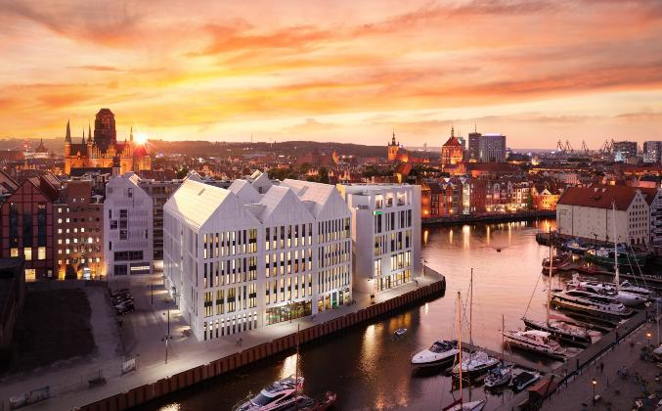
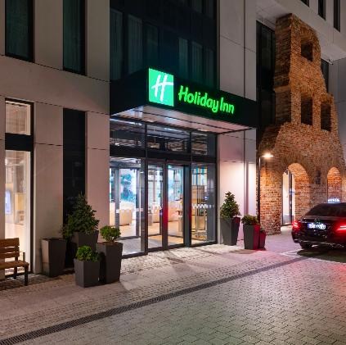
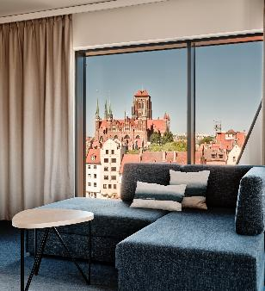
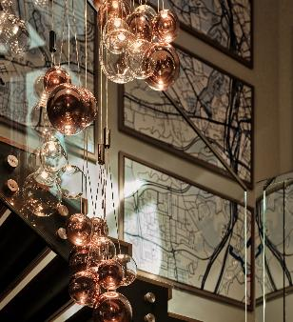

Holiday Inn gdańsk – City Centre
transportation
Holiday Inn® Gdańsk – City Centre is located in the heart of the Old Town, a unique urban concept at the mouth of the Motława River on the famous Granary Island.
Wake up to a wonderful view of historic Gdańsk and discover what the best Baltic destinations in Europe have to offer.
You will be captivated by the view of the calm waters of the Motława River, the yacht marina, the famous medieval crane, a rotating pedestrian bridge or the historic part of the city at your fingertips.
The walking spaces in Gdańsk, such as beaches and parks, make every stay more attractive.
FROM | DURATION | BY
Lech Wałęsa Airport | 25 min | Car
Central Station | 15 min | Walk
FROM | DURATION | BY
Forum Gdańsk | 10 min | Walk
Polsat Plus Arena | 15 min | Car
100cznia | 10 min | Car
Accommodation
Modern nautical-style rooms, each with a maritime accent, perfectly matching the FLOW concept of our hotel. Everyone will find something for themselves. From quiet standard rooms to suites.
Air-conditioned rooms overlooking the modern and historic part of the city as well as quiet rooms overlooking the hotel’s internal patio. There is a possibility of opening the window in each room.
The rooms are equipped with wide comfortable beds with a set of four pillows.
ROOM TYPES | NUMBER OF ROOM | AREA (SQM) | FLOORS
Standard | 236 | 18 - 28 | All Floor
Apartments | 4 | 32-34 | All Floor
Restaurant and bar
Holiday Inn Gdańsk – City Centre offers a wide selection of European cuisine. Dishes are prepared with fresh products from local suppliers. The restaurant seats 140 people and has direct access to the Motława River or to a quiet hotel patio, where you can enjoy breakfast or lunch outdoors. For those who want privacy, we have a private restaurant room where you can organize a meeting, business breakfast or private party. The Open Lobby is the perfect place to enjoy a freshly prepared meal, afternoon tea or have a drink with friends.
Horizon Restaurant
Sky Bar
The Horizon restaurant menu combines the local flavors of Pomerania with modern international culinary trends. Dishes are crafted from the highest-quality ingredients sourced from local suppliers. Special attention is given to carefully composed dishes inspired by traditional regional recipes, enhanced with the creative touches of our chef. The Horizon Restaurant at the Holiday Inn Gdańsk – City Centre is where culinary excellence meets unforgettable views of picturesque Gdańsk. Situated right on the edge of Granary Island, the restaurant offers guests a unique dining experience in an elegant yet cozy setting.
OPENING HOURS
BREAKFAST
Monday – Friday / 6:30AM – 10:30AM
Saturday– Sunday / 7:00AM – 11:00AM
LUNCH AND DINNER
Monday, Sunday / 2:00PM – 10:00PM
Tuesday – Saturday / 2:00PM – 11:00PM
SKY Bar Holiday Inn Gdańsk – City Center is a unique place with a view of the Old Town, the Motława River and the Gdańsk yacht marina.
Our bartenders are masters in preparing delicious cocktails, from classic to non-standard ones with surprising flavors.
The menu by Piotr Domański fits perfectly with the rich alcohol menu..
OPENING HOURS
Monday – Sunday
6:00PM – 11:00PM

Slide 2
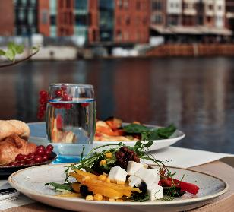
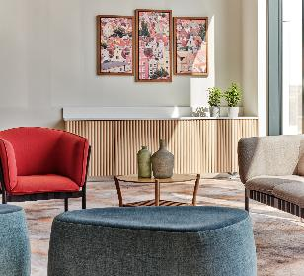
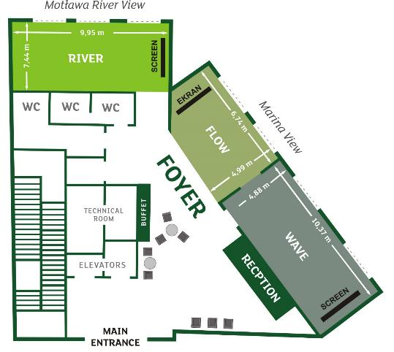
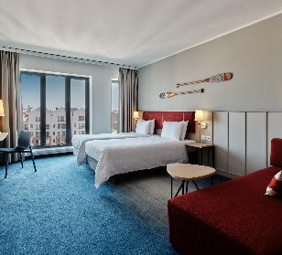
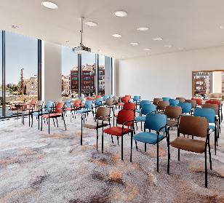
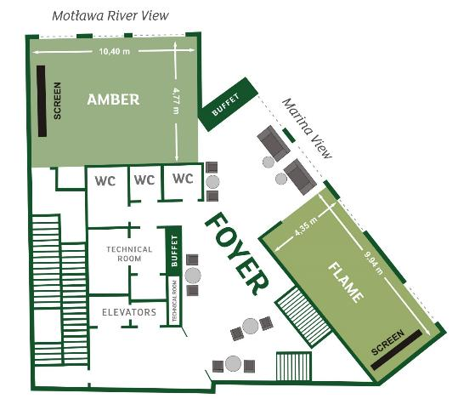
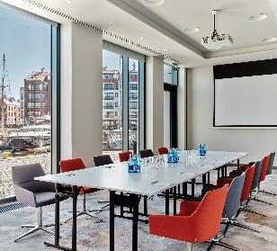
CONFERENCE CENTER AND MEETING SPACES
The conference rooms at the hotel located on Granary Island in Gdańsk offer a unique combination of modernity, historical surroundings, and picturesque views of the Motława River and the Old Town. Granary Island, one of the most prestigious and rapidly developing areas in Gdańsk, provides a unique atmosphere, perfect for organizing business events, conferences, and training sessions.
 | BOARD ROOM | SQUARE | U SHAPE | SCHOOL STYLE | BANQUET | THEATRE STYLE | CABARET
Ground floor
RIVER 50m² | 20 | 24 | 22 | 25 | 21 | 40 | 21
FLOW 35m² | 10 |  | 9 |  |  | 25
WAVE 55m² | 24 |  | 25 | 30 | 21 | 50 | 21
1st floor
AMBER 80m² | 25 | 35 | 30 | 35 | 40 | 75 | 40
FLAME 55m² | 25 | 25 | 25 | 30 | 21 | 50 | 21
Holiday Inn GDAŃSK – City Centre
ul. Chmielna 1 | 80-750 Gdańsk, Polska
p: +48 58 733 40 00 | e: HIGDANSK@ihg.com
www.Poland.ihg.com

